Slide 1
NYC Taxi time prediction
Represented –
Jaya dev Sahoo

Slide 2
Process
Step-1- understand the data. And business Analysis.
Step-2- Define Problem Statement.
Step-3-Data Cleaning.
Step-4-Data Analysis and Exploration.
Step-5-Data Modelling.
Step-6-Optimization and Deployment

Slide 3
Explanation
Check the basic info.
Dropped the pickup_datetime, dropoff_datetime, id,vendor_id because that value is not required.
Check the null value.
Check the outlier and avoid the outlier through box plot.

Slide 4
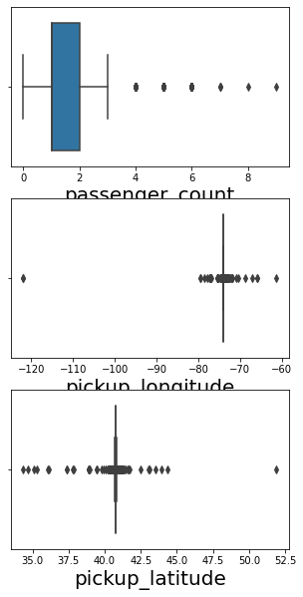
outlier

Slide 5
In “store_and_fwd_flag” categorical value to Numerical value.No change to “1”, yes change to “0”.
feature Selection through the correlation.
Choose the dependent value and independent value.
Train the model and the Test model.
Accuracy Value came 18

Slide 6
Model Summary
Standard Errors assume that the covariance matrix of the errors is correctly specified.
The condition number is large, 2.24e+05. This might indicate that there are strong multicollinearity or other numerical problems.

Slide 7
Conclusion
The Accuracy value came 18% so we reject this model

Slide 8
Thank You

